Slide 1


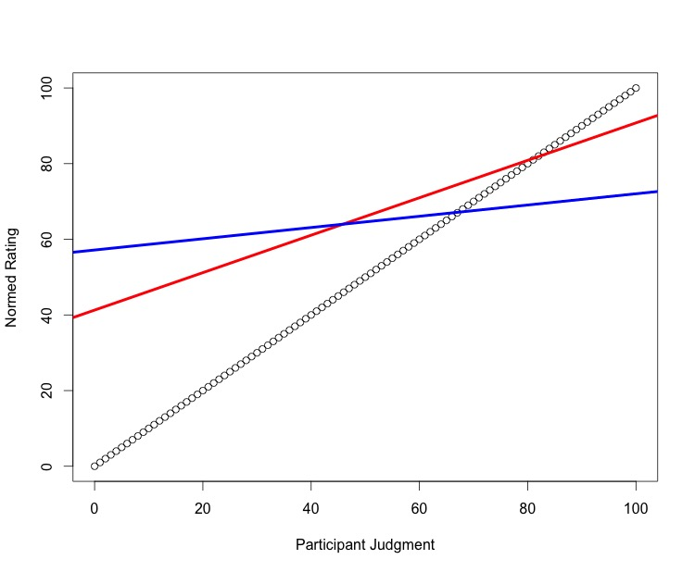
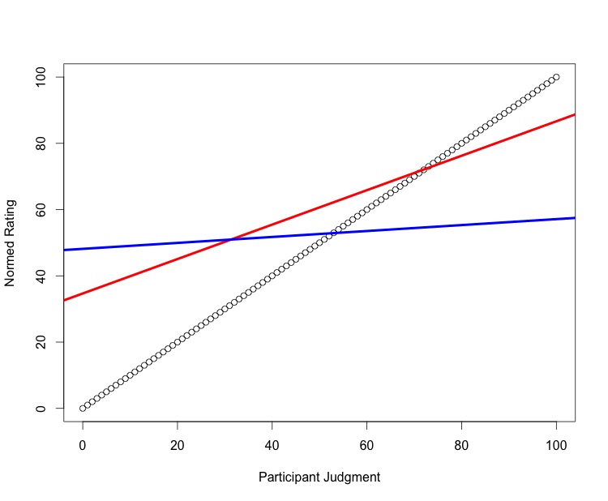
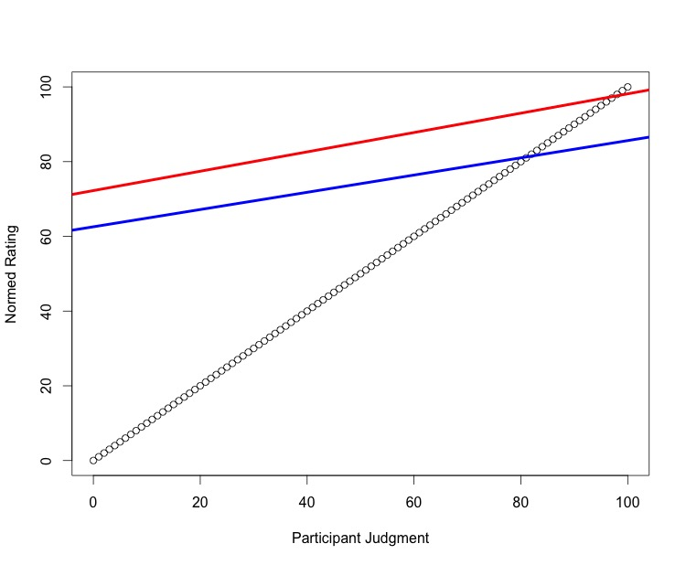
Individual Expertise in Underlying Memory Judgments
K.D. Valentine, University of Missouri, Erin M. Buchanan and Katherine Miller, Missouri State University
Abstract
Norming
Each experimental participant was tested five times.
“Please list the first four words that pop into your mind when you hear cue”.
Language use and meaning were disambiguated to focus on association, over definitions.
Free Association Testing
Average responses were made for each experimental participant.
Each person was asked: “When asked about cue, you listed the word target. What percent of the time did you put cue and target together?”
Matched group participants were asked to complete a normal FA task, but were matched to a specific experimental participant's norms.
Variables
Slope and intercept values for each participant compared to words in/not in the free association database but tied to experimental group norms (expert) as well as free association norms (collective), were calculated as the dependent variables for this study.
Judgments compared to experimental ratings in the free association database.
Ratings of individualized norms > ratings of matched norms.
Slight advantage of match to database (see below).
Research in judgments of memory indicates that we still need to understand how underlying sorting and judgment from memory is accomplished.
In this study, participants created their own set of free association norms over five testing trials and were then asked to judge the associative strength of their word pairs.
These judgments were then compared to real associative strengths, a control group, and a matched group.
Participants who judged their own pairs were better than all other groups implying that judgments based on individualized generated memories are better than judging the collective norm, but are, albeit, still far from perfect.
Judgments compared to experimental ratings not in the free association database.
Ratings of individualized norms > ratings of matched norms
Introduction
Koriat and Bjork (2005, 2006) showed the importance of exploring judgment processes for learners as judgments of learning (JOLs) were heavily biased, often to the learners’ disadvantage.
In a free association (FA) task, participants are given a cue word and asked to respond with the first target word that comes to mind. The USF norms contain thousands of cue-target pairs with percent responses for each combination.
In Maki’s (2006a; 2006b) studies, participants completed a judgments of associative memory (JAM) task using those norms as a comparison rubric.
Participants were given cue-target pairs and asked to judge their relation by guessing the number of people who would say the target word if first shown the cue word.
For example, if shown off, how many people would say on?
Participant’s bias was calculated as the intercept value when using participant judgments to predict normed information. Their sensitivity to differences in relation strength was measured using the slope of that regression analysis.
Valentine and Buchanan (2012) found that these slope and intercept values are extremely consistent across studies of JAM, indicating that judgments are upwardly biased and rather insensitive to differences in memory strength.
Judgments compared to database ratings.
Experimental groups = matched groups when compared to collective data.
Results
2 (experimental vs. matched) X 3(yes/no/database) Repeated Measures ANOVAs were conducted to compare the slope and intercept values for groups.
Significant interaction effects indicated a difference in slope and intercepts for matched versus experimental groups by normed information type. Paired t-tests were used to analyze this interaction.
Means (SD), F-test, t-tests presented below.
Blue lines indicate matched, red lines indicate experimental.
Discussion
Slope | Yes | No | Database | Omnibus
Experimental | 0.495 (0.256) | 0.521 (0.225) | 0.259 0(.196) | F(2, 80) = 20.147 p < .001 η_{p}² = .335
Matched | 0.149 (0.258) | 0.092 (0.187) | 0.230 (0.230) | F(2, 80) = 5.332 p = .007 η_{p}² = .118
Simple Effects | t(40) = 6.216 p < .001 d = 0.971 | t(40) = 8.482 p < .001 d = 1.325 | t(40) = 0.645 p = .522 d = 0.101 | F(2, 80) = 24.025 p < .00 η_{p}² = .375
The experimental group had steeper slopes (i.e., more sensitivity) and lower intercepts (i.e., less bias) when calculated with their norms versus database norms, which indicated that judgments of individualized information were much more accurate than collective information.
The matched group showed this effect was not simply due to easier cue-target pairs to guess, as their steepest slopes were when compared to the database norms.
Intercepts were still upwardly biased, but were decreased in the no database calculations, matching Maki’s previous results showing that pairs with no known relationship show decreased bias in judgments.
Method
Participants
Experimental, N = 41
Matched, N = 41
Stimuli
Chosen from the free association database (Nelson et al., 2004)
20 cue words with >= 10 target words were selected to allow for a variety of answers.
Intercept | Yes | No | Database | Omnibus
Experimental | 41.282 (22.946) | 34.683 (16.358) | 72.252 (12.030) | F(2, 80) = 84.078 p < .001 η_{p}² = .678
Matched | 57.165 (21.618) | 48.153 (17.410) | 62.564 (14.928) | F(1.737, 80) = 13.801 p < .001 η_{p}² = .257
Simple Effects | t(40) = -3.424 p = .001 d = 0.535 | t(40) = -3.523 p = .001 d = 0.550 | t(40) = 3.831 p < .001 d = 0.598 | F(2, 80) = 22.940 p < .001 η_{p}² = .364
Contact
Corresponding author: erinbuchanan@missouristate.edu
Corresponding author: katy.valentine3@gmail.com

